Slide 1

TCP Client/Server Chat Program
Ali Zamin

Slide 2
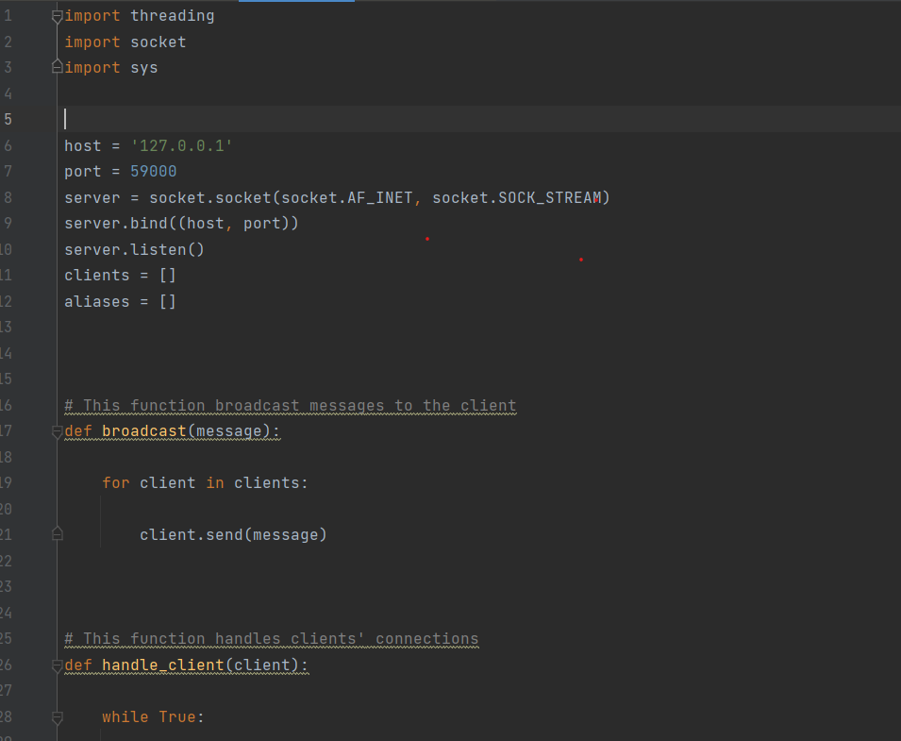
Server.py
Built in libraries, including threading, socket, and sys
Creates the server socket
Initialize host and IP address.

Slide 3
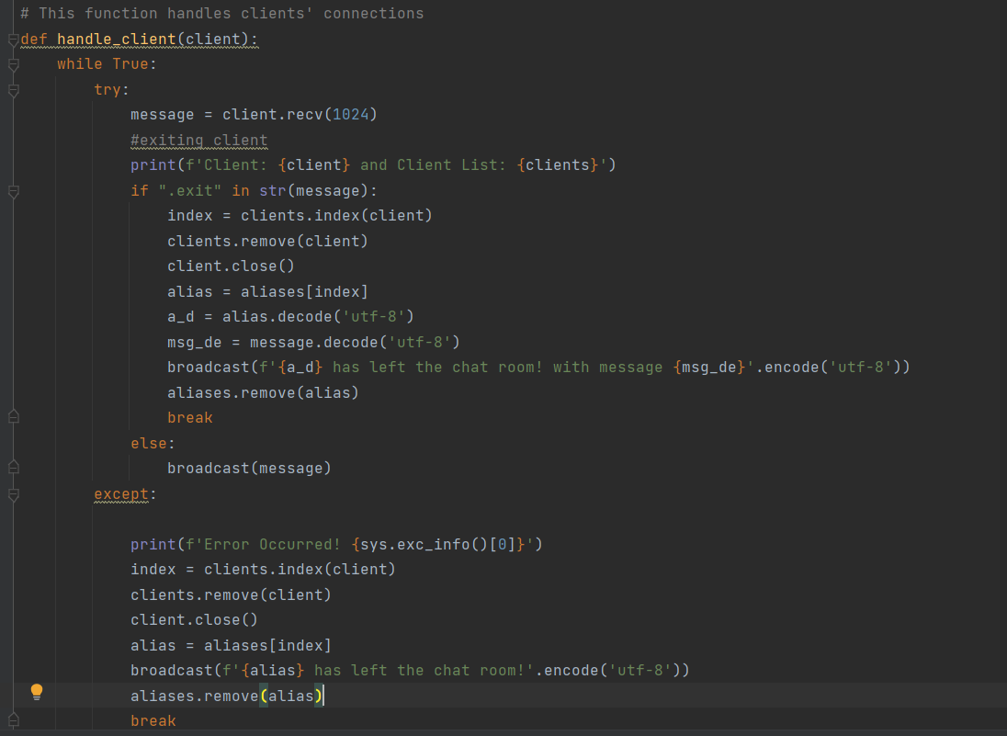
Server.py
Handle_client function deals with managing users like removing users from chat room.

Slide 4
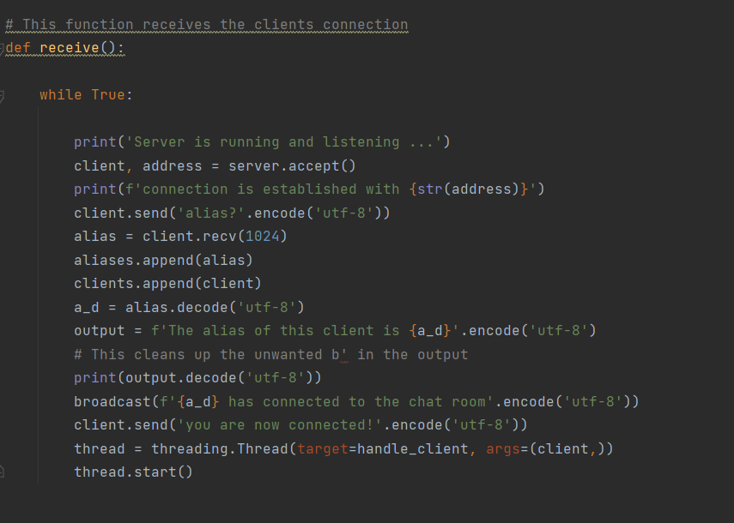
Server.py
Receive() function receives client connection and tells us who joined the chat.

Slide 5
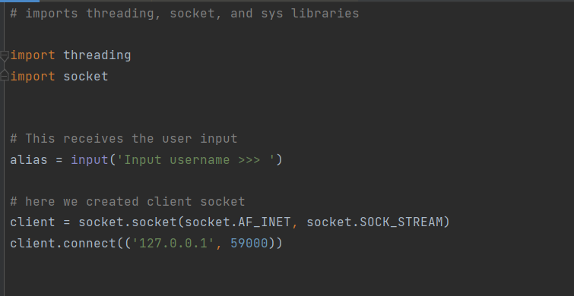
Client.py

Slide 6
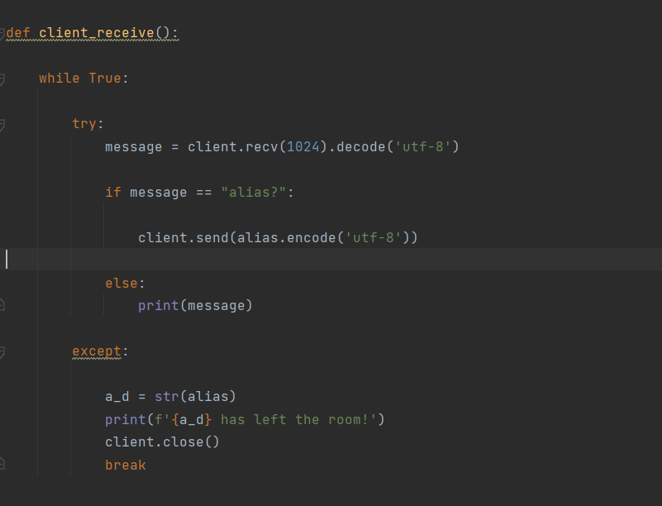
Client.py
Client_receive() function checks for user input. If found then, sends the to server
If the alias matches with the server, it continues the conversation.
Otherwise, it terminates the connection between the server and client.

Slide 7
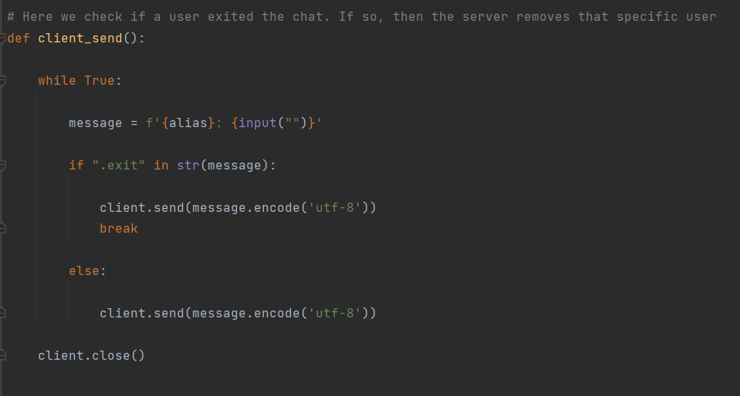
Client.py
client_send() function checks if a user exited the chat. If so, then the server removes that specific user.

Slide 8

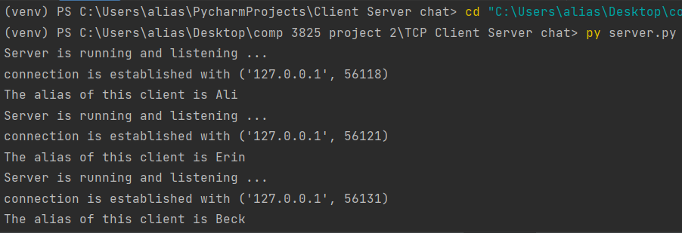
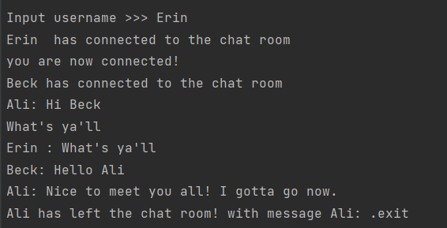
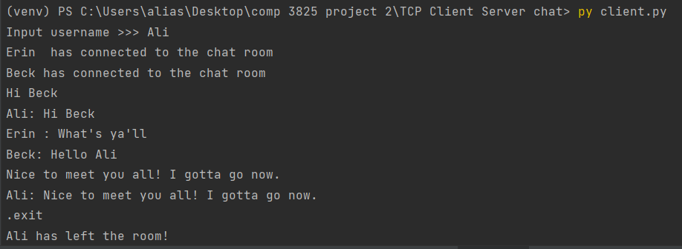
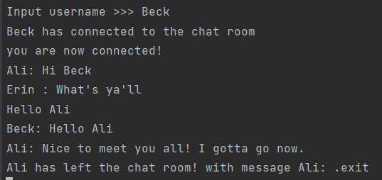

Slide 9
Reference
https://ubidots.com/blog/how-to-simulate-a-tcpudp-client-using-netcat/
https://bogotobogo.com/python/python_network_programming_server_client.php

